Slide 1

NFL RB workload and efficiency
Izaak King

Slide 2

Context
Historically, many NFL teams have relied on a “bell cow” running back
High volume: One player is the primary ball carrier, receiving a high number of touches each game
Lead back may receive 75% or more of the team’s rush attempts
As of late, NFL teams have adopted a “running back by committee” approach
Split workload: Spreading the workload across multiple players can help running backs stay healthy and “fresh”
Specialized Roles: Teams can use running backs with different skill-sets in different roles, like the “power back” or “pass-catching back”
Notes:
Historically, NFL teams often relied on a single “bell cow” running back.
This player handled most of the team’s carries, sometimes 75% or more
Recently, teams have shifted toward a “running back by committee” approach.
Workload is split among multiple backs to keep players healthy and fresh.
Teams can assign specialized roles, like a power back for short-yardage or a pass-catching back.

Slide 3

Problem Area
Is this approach effective? Are running backs with a smaller workload more effective than running backs with a larger, “bell cow” workload?
Hypothesis: If a running back has a larger workload, then their efficiency will be lower on average compared to running backs with a smaller workload.
Running back efficiency decreases as workload increases
Notes:
The problem we’re exploring: Is the “bell cow” vs committee approach more effective?
Do running backs with smaller workloads perform more efficiently than high-volume backs?
Our hypothesis: As a running back’s workload increases, their efficiency tends to decrease.
In other words, higher-touch RBs are expected to be slightly less efficient on average.

Slide 4

Data
Source: https://www.pro-football-reference.com/
Reliable, widely used source of NFL statistics
Dataset:
Data scraped from Pro-Football-Reference (1996–2024)
Script to filter data by RBs only, minimum of 50 touches in a season
Running back workload measured in touches (rush or reception)
Running back efficiency measured in average yards per touch
Notes:
Data comes from Pro-Football-Reference, a reliable and widely used source for NFL stats.
Dataset covers 1996–2024, filtered for running backs with at least 50 touches per season.
Workload is measured by total touches, including rushes and receptions.
Efficiency is measured as average yards per touch.

Slide 5
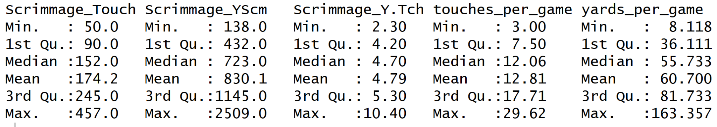
Summary of RB Workload and Efficiency Metrics
The summary shows that most RBs accumulate between ~90–250 touches per season, with median efficiency around 4.7 yards per touch and ~56 yards per game. Total yards vary more widely, reflecting differences in workload and team offensive schemes.
Notes:
Most running backs record roughly 90–250 touches per season.
Median efficiency is around 4.7 yards per touch, with about 56 yards per game.
Total yards vary widely, reflecting differences in team offenses and individual workloads.
Some RBs reach very high totals, up to 457 touches or over 2,500 scrimmage yards in a season, showing the range between typical and workhorse backs.

Slide 6
Exploratory Analysis
Distributions
Workload skewed right; bell-cow seasons rare
Efficiency tightly clusters around ~4–5 yards per touch
Relationships
Weak negative correlation (touches vs Y/T)
Strong positive correlation (touches vs yards/game)
Notes:
Looking at the distributions, Workloads are right-skewed, indicating most seasons are moderate, and bell-cow seasons are uncommon.
Efficiency clusters tightly around 4–5 yards per touch.
Relationships:
Weak negative correlation between touches and yards per touch
Strong positive correlation between touches and total yards per game, higher workload leads to more total production.

Slide 7
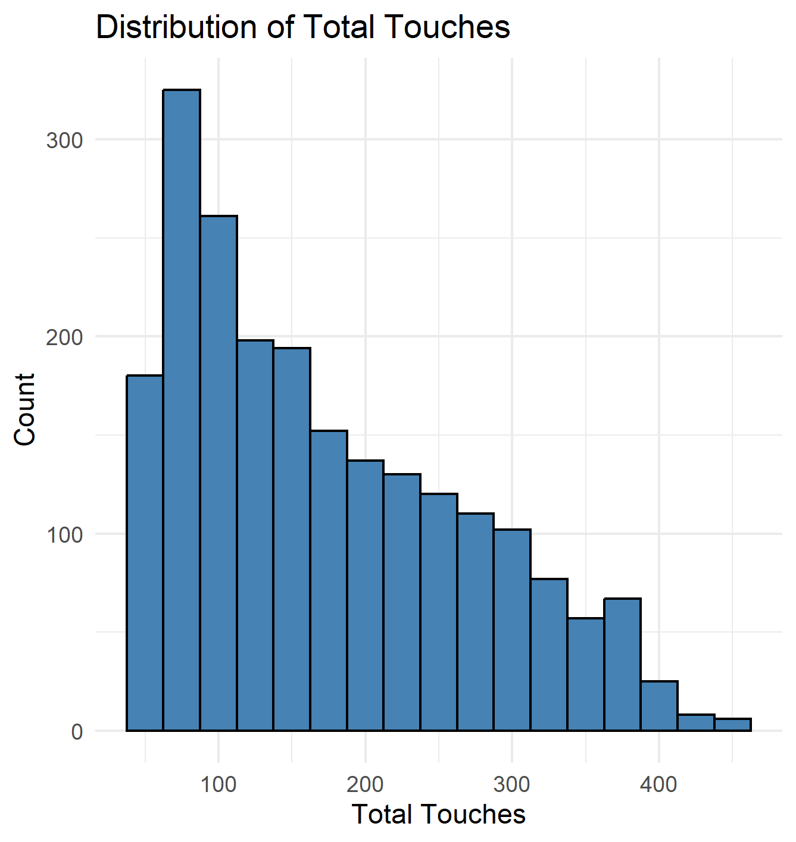
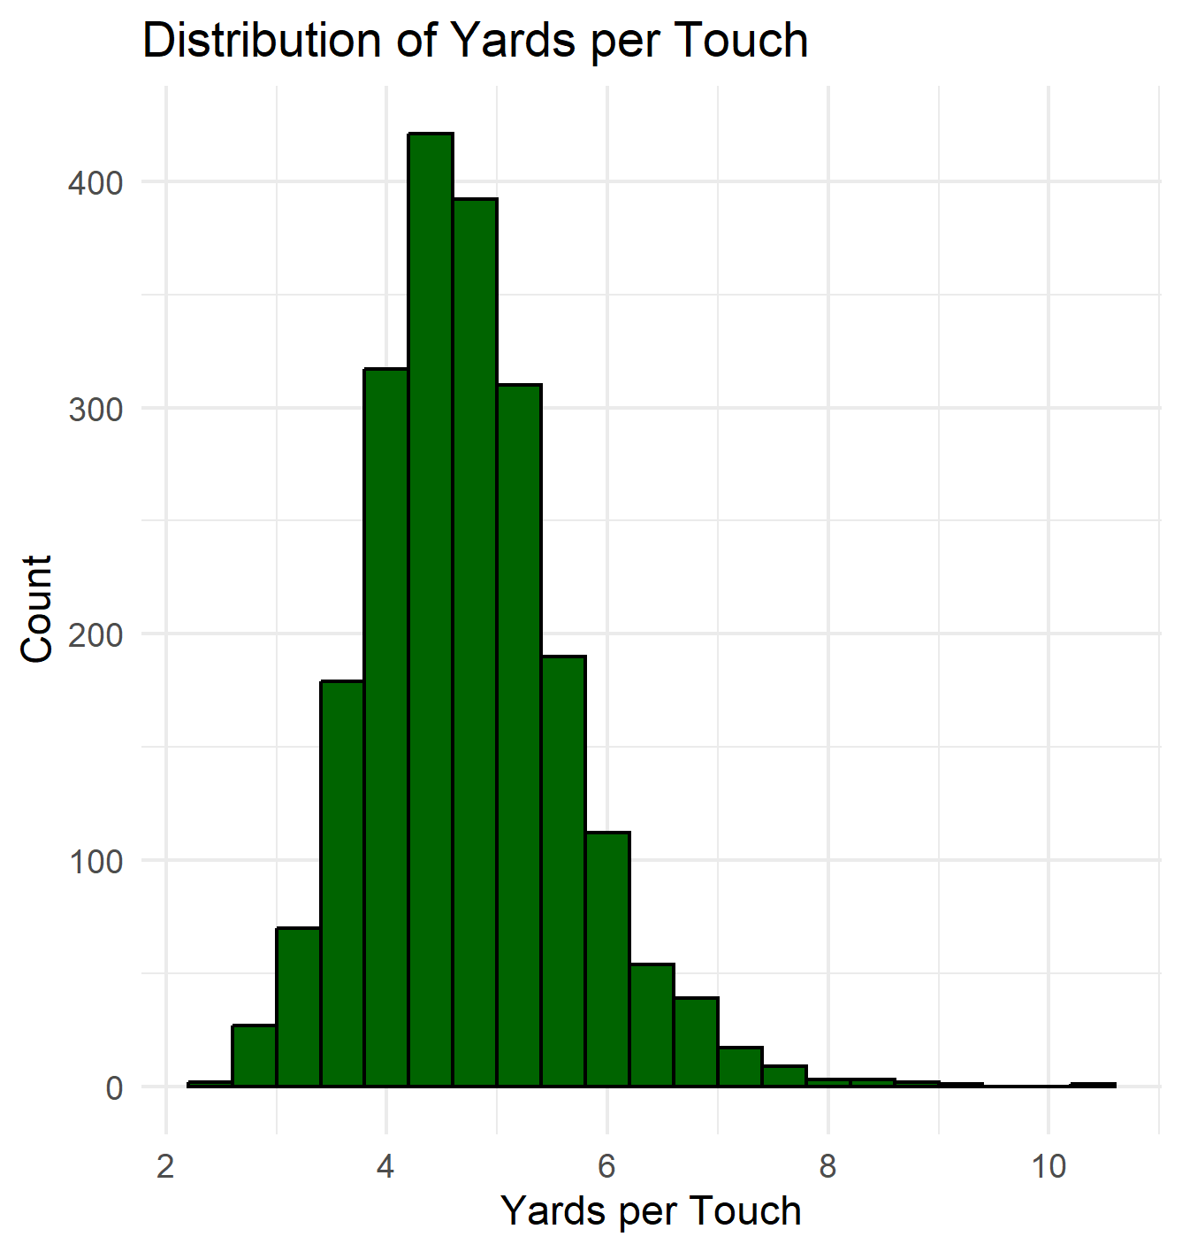
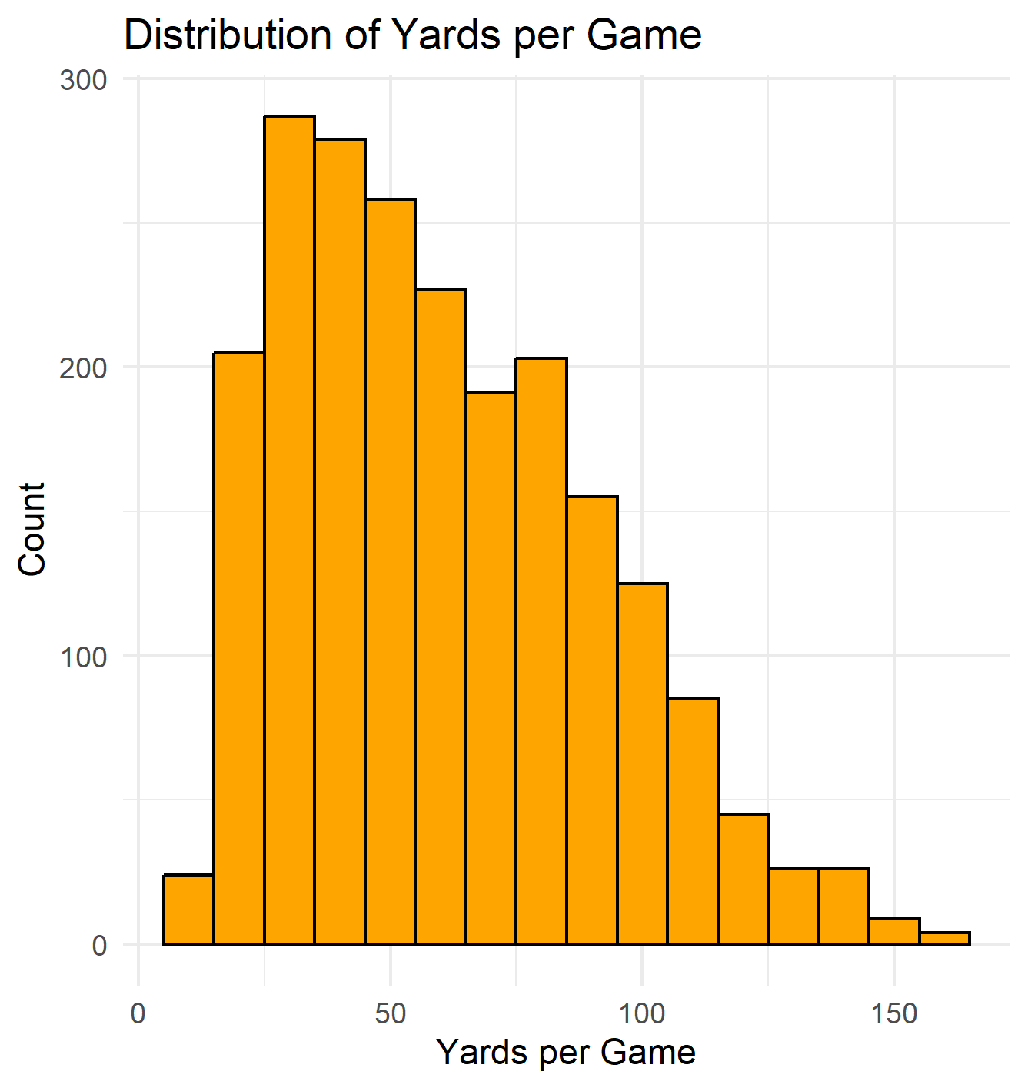
Distributions
Distribution of Total Touches Among RBs
Distribution of Yards per Touch
Distribution of Yards per Game
The histograms show that most running backs fall below 250 total touches per season, with a steep drop-off beyond 300, indicating that true 'bell cow' backs are rare. Efficiency, measured in yards per touch, is tightly clustered between 4 and 5 yards, with few players exceeding 6. Meanwhile, yards per game exhibit broader variation, reflecting the combined influence of both volume and efficiency, with some players achieving high yardage through consistent workload, while others rely on explosive playmaking.
Notes:
Histograms show most RBs have fewer than 250 touches per season; true bell-cow seasons are rare.
Yards per touch clusters tightly between 4–5 yards, with few exceeding 6.
Yards per game vary more widely, reflecting both workload and efficiency.
Some RBs achieve high totals through consistent touches, others through big-play ability.

Slide 8
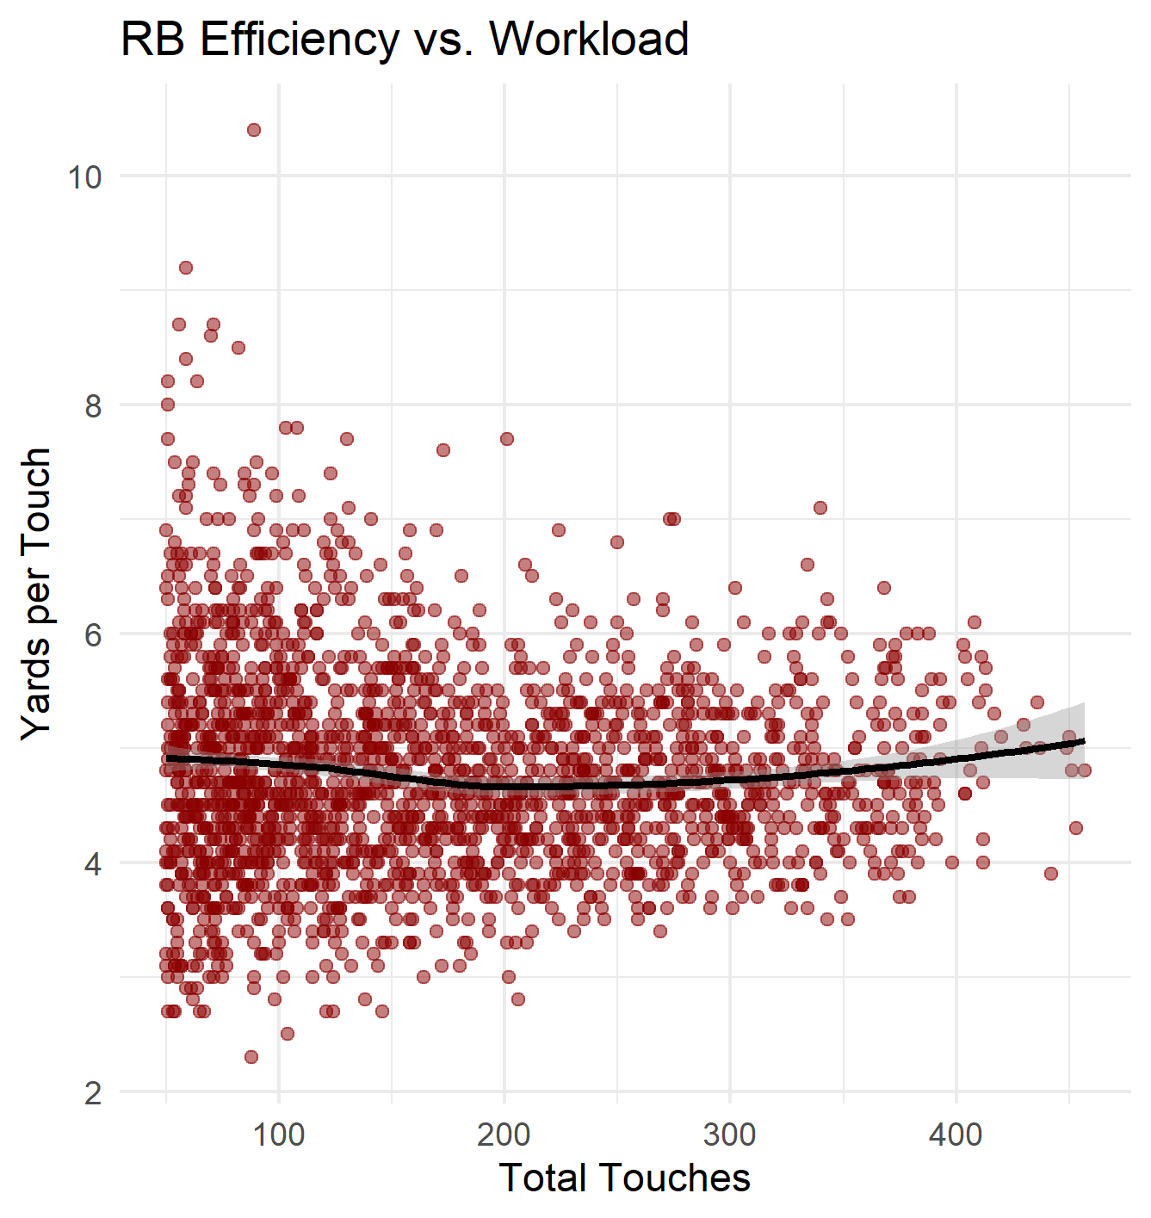
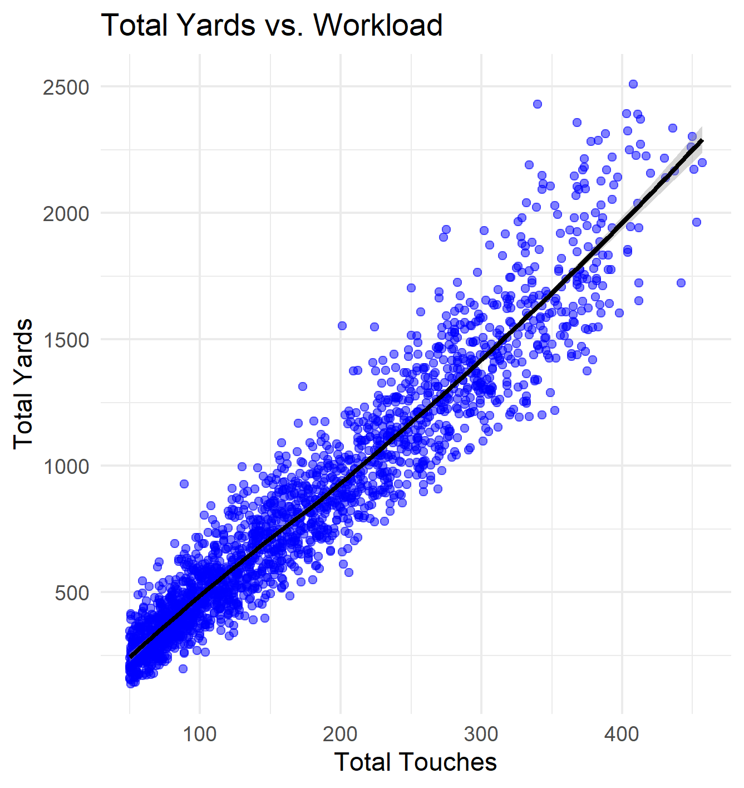
Relationships
RB Efficiency vs. Total Touches
Total Yards vs. Total Touches
Efficiency (yards per touch) remains stable across workloads, while total yardage predictably increases with touches. High-volume running backs maintain comparable per-touch productivity, but accumulate significantly more total yards as workload rises.”
Notes:
Efficiency (yards per touch) stays relatively stable, even as workload increases.
Total yards increase predictably with more touches.
High-volume RBs don’t lose much per-touch productivity, but they rack up significantly more total yards due to their larger workload.

Slide 9
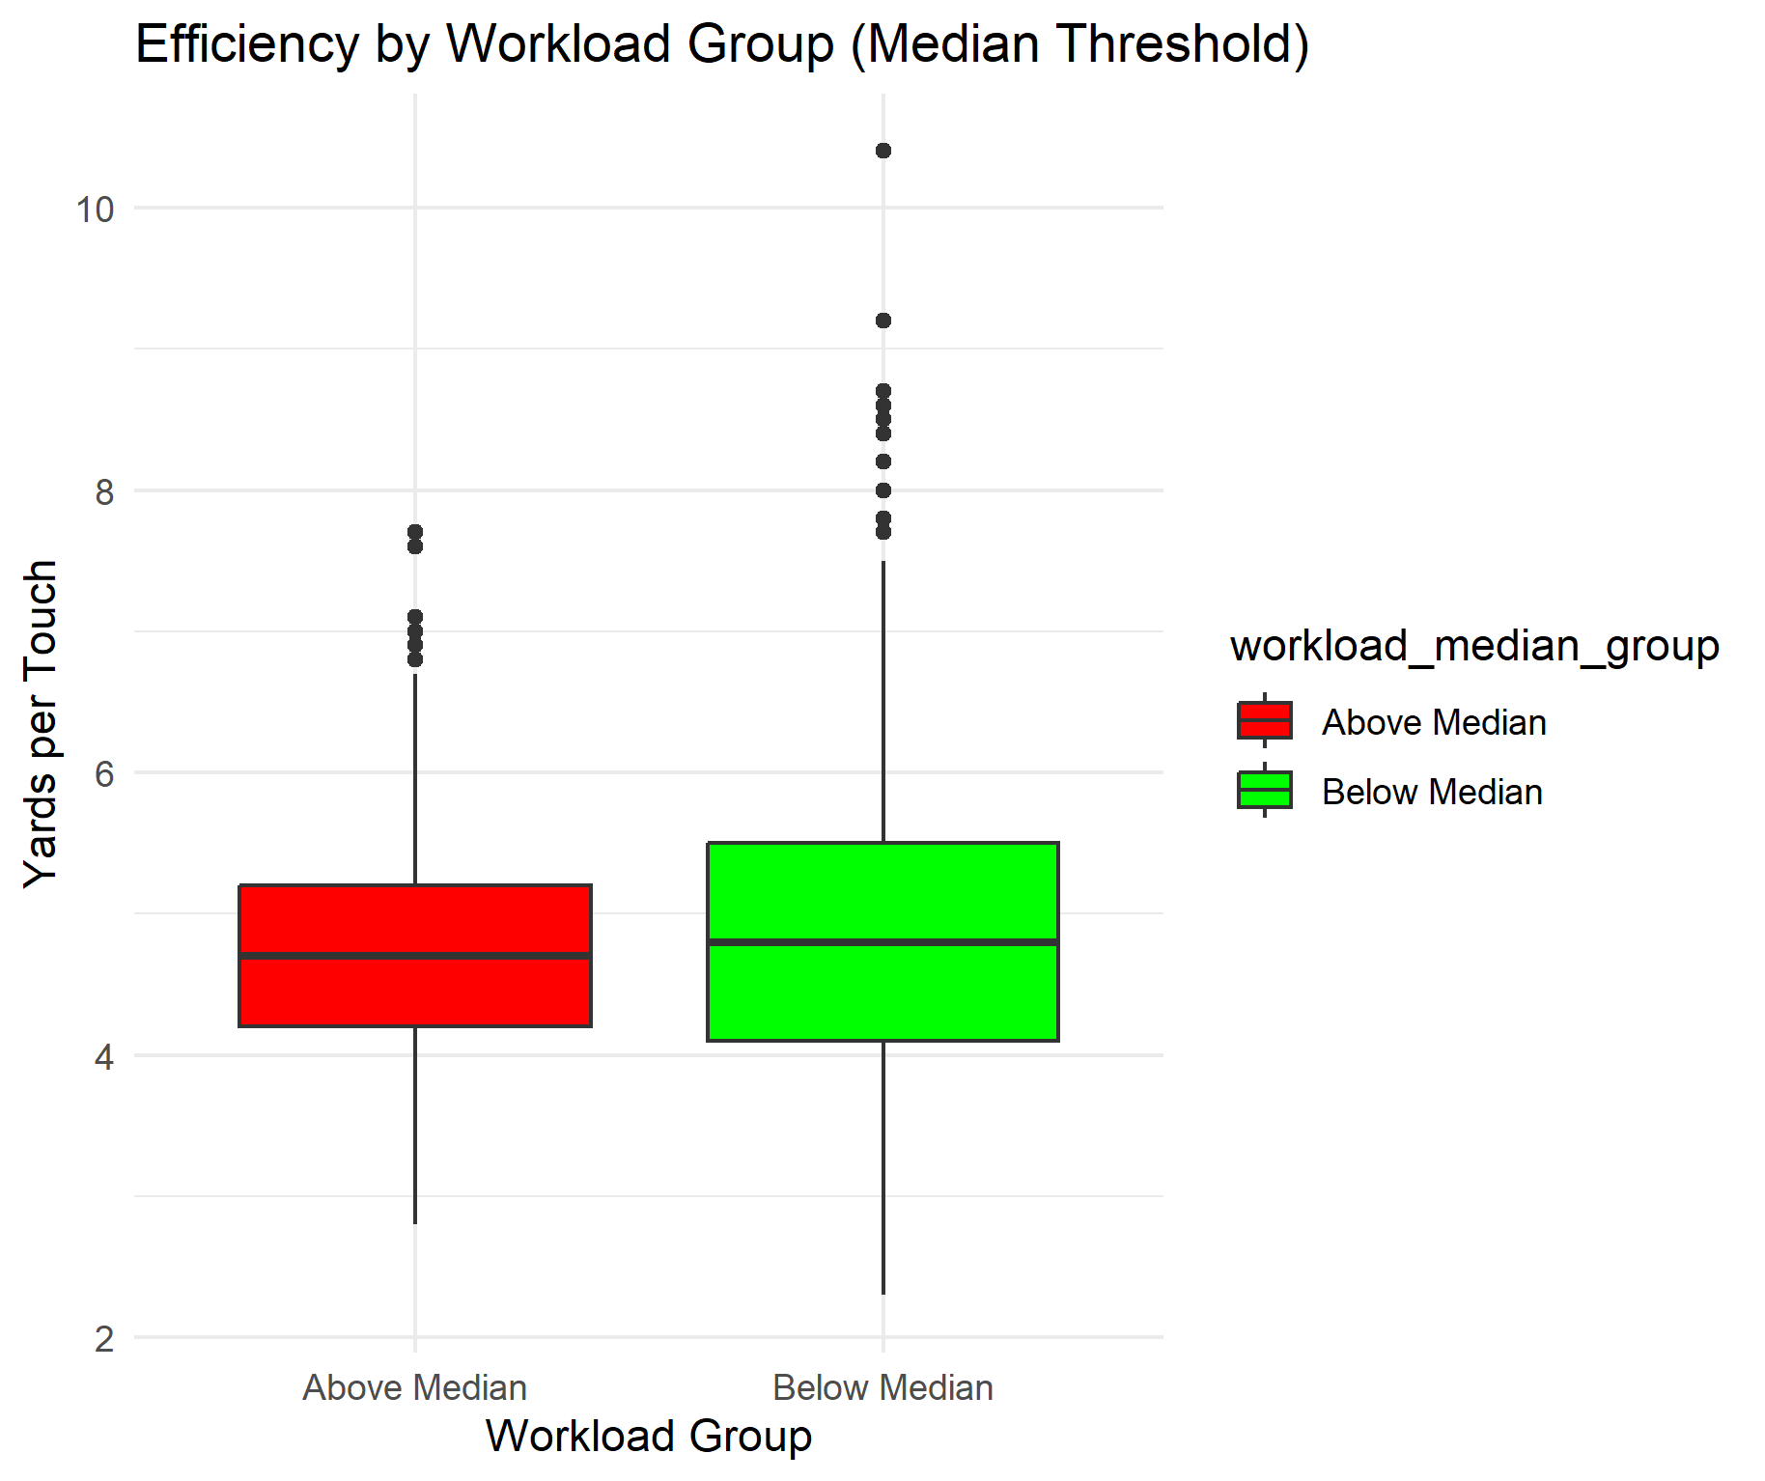
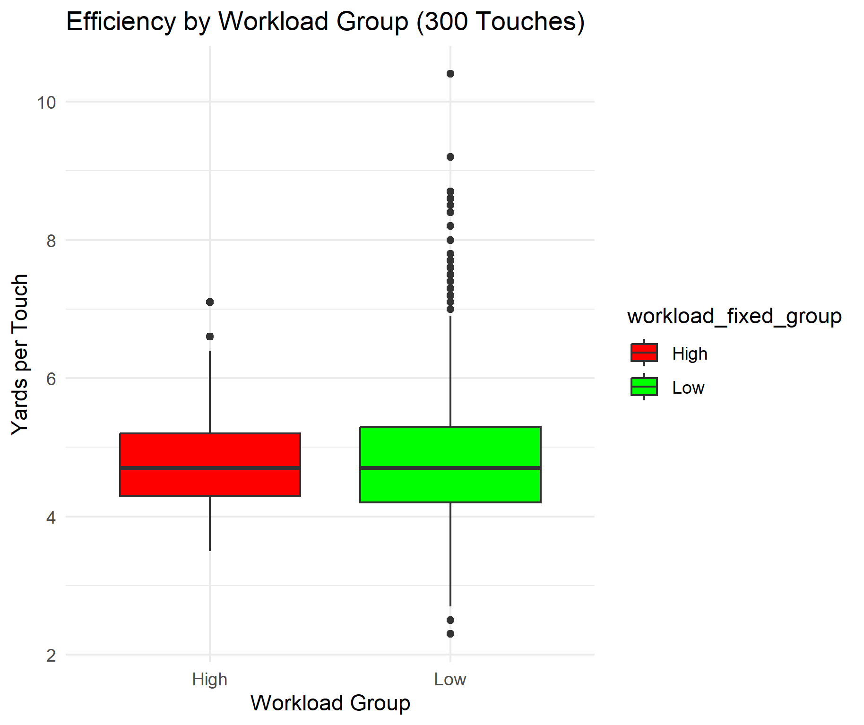
Efficiency by Workloads
Efficiency by Workload Group (Median Threshold)
Efficiency by Workload Group (300 Touches Threshold)
Across both grouping methods, running back efficiency remains tightly clustered: RBs above the median workload show only a slight drop in median yards per touch, while even extremely high-workload backs (300+ touches) maintain efficiency nearly identical to lower-workload players. High-volume backs also display a more consistent efficiency range, suggesting that teams concentrate large workloads on stable, reliable performers.
Notes:
Efficiency stays tightly clustered across workload groups.
RBs above the median workload show only a slight drop in median yards per touch.
We can see even very high-workload RBs (300+ touches) maintain efficiency similar to lower-workload backs.
High-volume RBs also show a more consistent range efficiency, suggesting teams rely on dependable performers for heavy workloads.

Slide 10
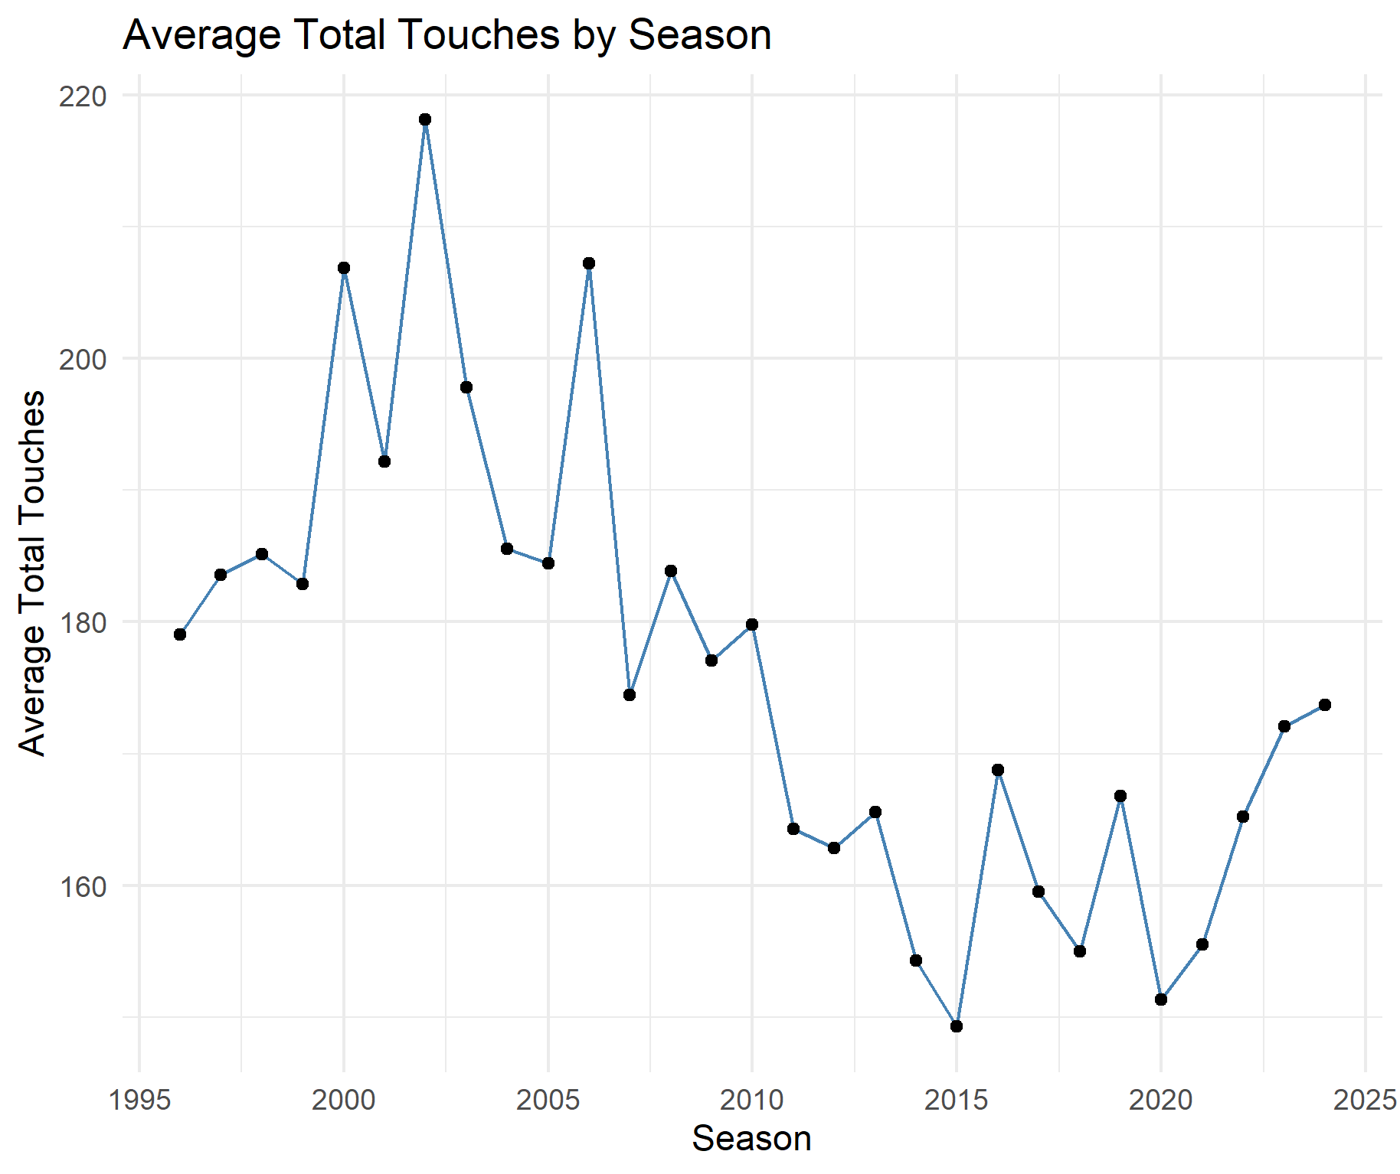
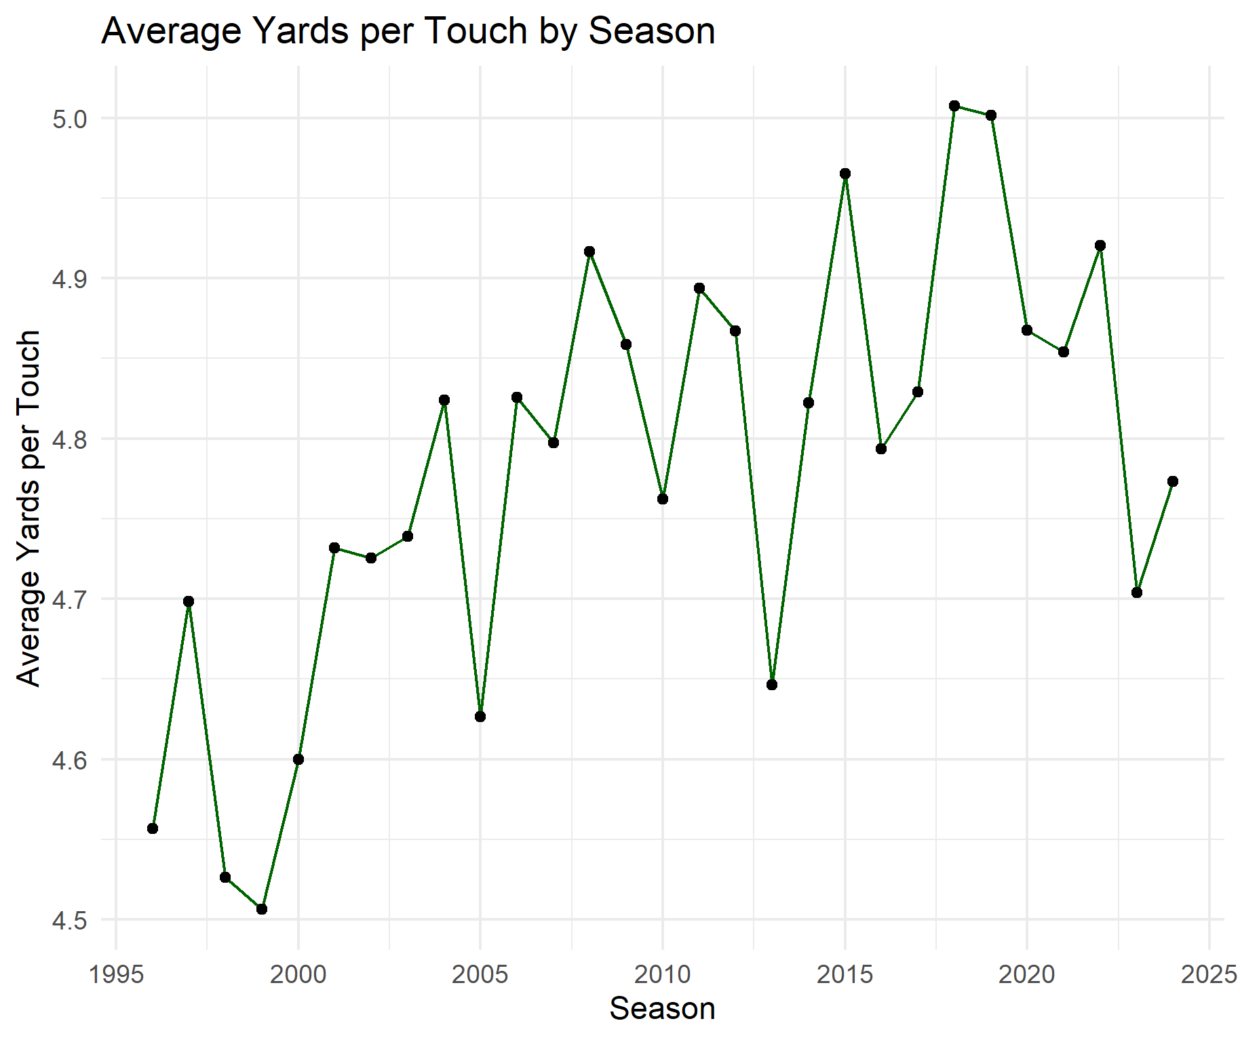
Seasonal Trends
Average Total Touches by Season
Average Yards per Touch by Season
Across seasons, running back efficiency (yards per touch) has remained consistently stable around 4.5–5.0 yards, while average workloads have gradually declined over time. Occasional spikes in total touches reflect seasons with prominent workhorse backs, but overall trends show decreasing RB usage alongside steady per-touch productivity.
Notes:
Looking at long-term seasonal trends, RB efficiency has stayed very stable, usually between 4.5 and 5 yards per touch each season.
Meanwhile, average workloads have gradually declined as teams shift away from heavy usage.
We still see occasional spikes in touches when certain teams rely on a true workhorse, but overall the league trend is reduced RB volume with steady (possibly increasing) efficiency.

Slide 11
Hypothesis Test
Welch's t-tests were used to test workload effects on efficiency
Median split (152 touches):
Above-median RBs had slightly lower efficiency (4.72 vs. 4.86 Y/T)
Difference was statistically significant (p < 0.001)
300-touch threshold:
High-workload RBs showed no significant difference (both 4.79 Y/T)
p = 0.97 indicates efficiency is unchanged at extreme workloads
Conclusion:
Moderate workload increases slightly reduce efficiency
Very high workloads do not lead to meaningful efficiency decline
Notes:
To test whether workload affects efficiency, I used Welch’s t-tests for two different workload splits.
With a median split, higher-workload RBs showed a small but statistically significant drop in efficiency, with a drop of about 0.14 yards per touch for RBs above the median
But when using a 300-touch threshold, there was no difference at all. Both groups averaged 4.79 Y/T, and the p-value was almost 1.
So overall, moderate increases in workload show a tiny efficiency dip, but extremely high workloads don’t cause meaningful efficiency loss.

Slide 12
Linear Regression
Model 1: Total Touches → Efficiency
Simple linear regression, total touches as predictor
Small but significant negative effect: β = –0.00046, p = 0.023
Very low explanatory power: R² ≈ 0.002
Model 2: Multivariate Regression
Predictors: touches, age, yards/game, touches/game
Strong explanatory power: R² ≈ 0.766
Yards/game: strong positive predictor (p < 2e–16)
Conclusion:
Efficiency depends on multiple factors
Per-game usage and productivity matter most
Total touches alone are poor predictors
Notes:
First I ran a simple regression using total touches to predict efficiency.
Touches had a small but statistically significant negative effect, but the model explained almost none of the variation in efficiency… the R² was basically zero.
Then I added more context with a multivariate model: touches, age, yards per game, and touches per game.
This model performed much better, explaining about 77% of the variance
Yards per game was by far the strongest predictor, with touches per game adding additional context.
The takeaway is that efficiency isn’t driven by raw volume. It’s influenced by multiple factors, especially per-game usage and productivity.

Slide 13
K-means Clustering
Features: Total touches, yards per touch, yards per game
k = 2–8 evaluated with WCSS & silhouette widths
Final Model (k = 2):
Cluster 1: moderate touches/efficiency (n = 1,349)
Cluster 2: high-touch or high-yards-per-touch RBs (n = 800)
Silhouette scores: 0.40 & 0.43 → reasonable separation
Conclusion:
RBs naturally group by workload and efficiency
Distinguishes typical players from high-usage/high-efficiency players
Notes:
Next I used k-means clustering to see whether running backs naturally group based on workload and efficiency.
The features were total touches, yards per touch, and yards per game, and I tested k values from 2 to 8.
Based on WCSS and silhouette scores, the best fit was k = 2.
The first cluster represents RBs with moderate workloads and efficiency, while the second cluster includes high-touch or high-efficiency players.
The silhouette scores around 0.40 show the clusters are reasonably well separated.
Overall, this confirms that RBs tend to group into typical-volume players and high-usage or highly efficient players.

Slide 14
Conclusion
RB efficiency is remarkably stable across workloads
Total touches explain little variance
Per-game metrics (Y/G, T/G) drive most efficiency variation
Two clear RB archetypes emerge from clustering
Results support informed workload planning
Notes:
Overall, the main takeaway is that running back efficiency stays very consistent, no matter how big the workload is.
Total touches alone don’t explain much, they’re a poor predictor of how efficient a player will be.
Instead, per-game metrics like yards per game and touches per game account for most of the variation in efficiency.
The clustering results also show two clear archetypes of typical-volume backs and high-usage or high-efficiency backs.
Altogether, these findings suggest teams can make smarter workload decisions without worrying that giving a back more touches will significantly hurt efficiency.

